Slide 1
Rampaging Chariots
2024
Notes:
Peter Metcalfe

Slide 2

Who are we?
Leonardo is a world leader in the aerospace, defense and security sector, with a wide range of products.

Slide 3
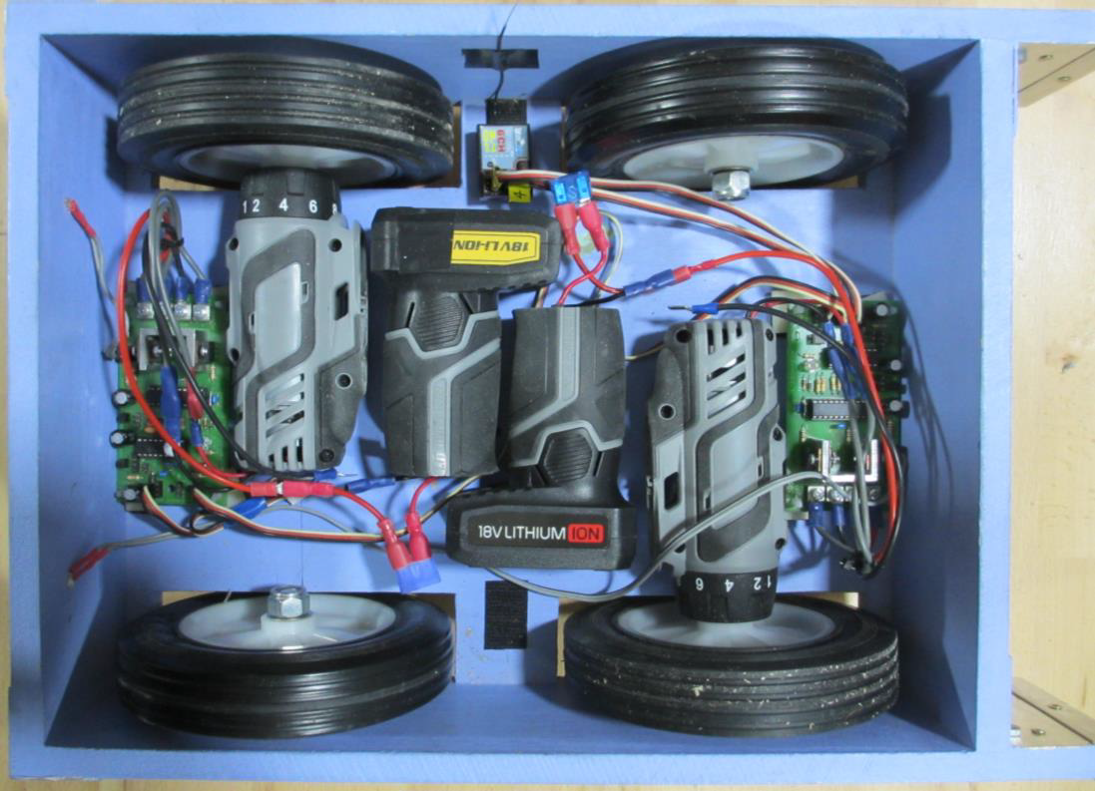
What is a Rampaging Chariot?
A Rampaging Chariot is a powerful radio controlled robot.
Originally inspired from Robot Wars.
The standard Chariot kit is devised of 330 parts.
Built and developed by schools and youth groups.

Slide 4
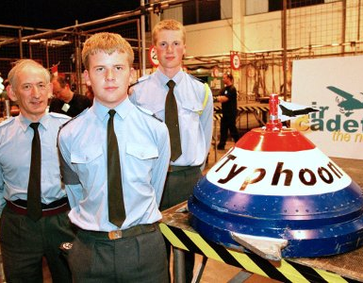
History
Rampaging Chariots was initially developed by Peter Bennett, an ex Robot Wars champion, in 2005.
As a means to promote STEM activities within schools.

Slide 5
History
He built the robot ‘Typhoon’ along with five other engineers from Leonardo’s Airborne & Space Systems Division.
Which went on to win 5 Robot Wars titles, 2 Techno Games titles and the world Olympics silver medal in 2005.

Slide 6
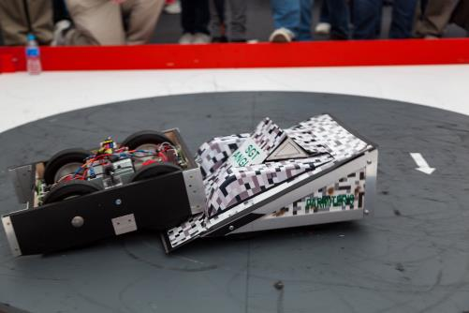
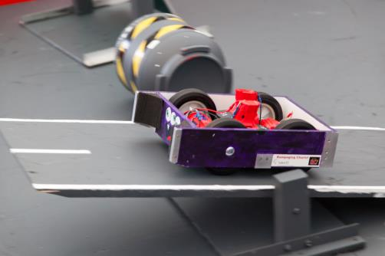
The Competition
Build your chariot.
Compete against other schools.
The fastest and strongest wins.
Held at our Luton site.
Consists of 4 events.
Awards for each event and more…

Slide 7
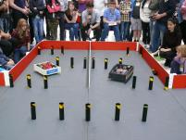
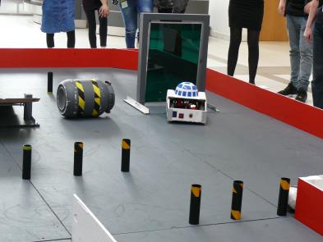
Obstacle Course
Two teams compete against each other to be the fastest around the course.
The course consist of:
Scoring a goal
Moving a barrel
Going though a door
Traveling over a ramp
A lot of skill!

Slide 8
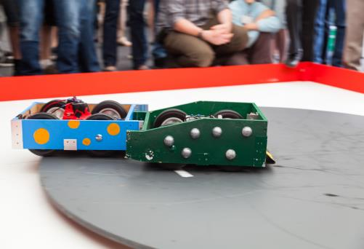
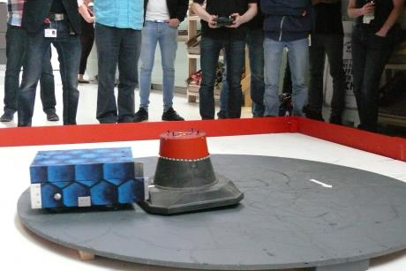
Sumo
Two chariots compete head to head to try push the other chariot out of the ring.
It is the best of three and the winner will go through to the next round.

Slide 9
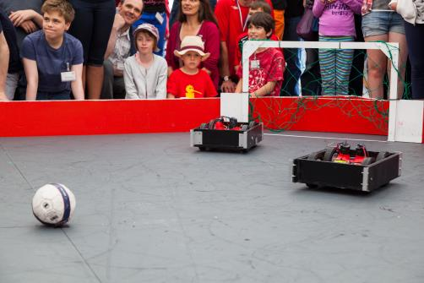
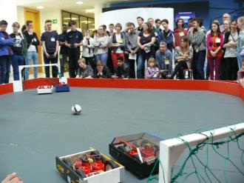
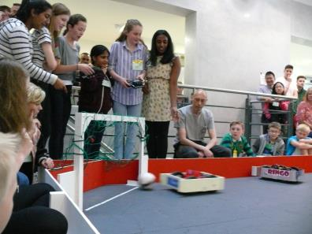
Football
2-a-side game that lasts 5 minutes.
The chariots to score the most goals will go through to the next round.

Slide 10
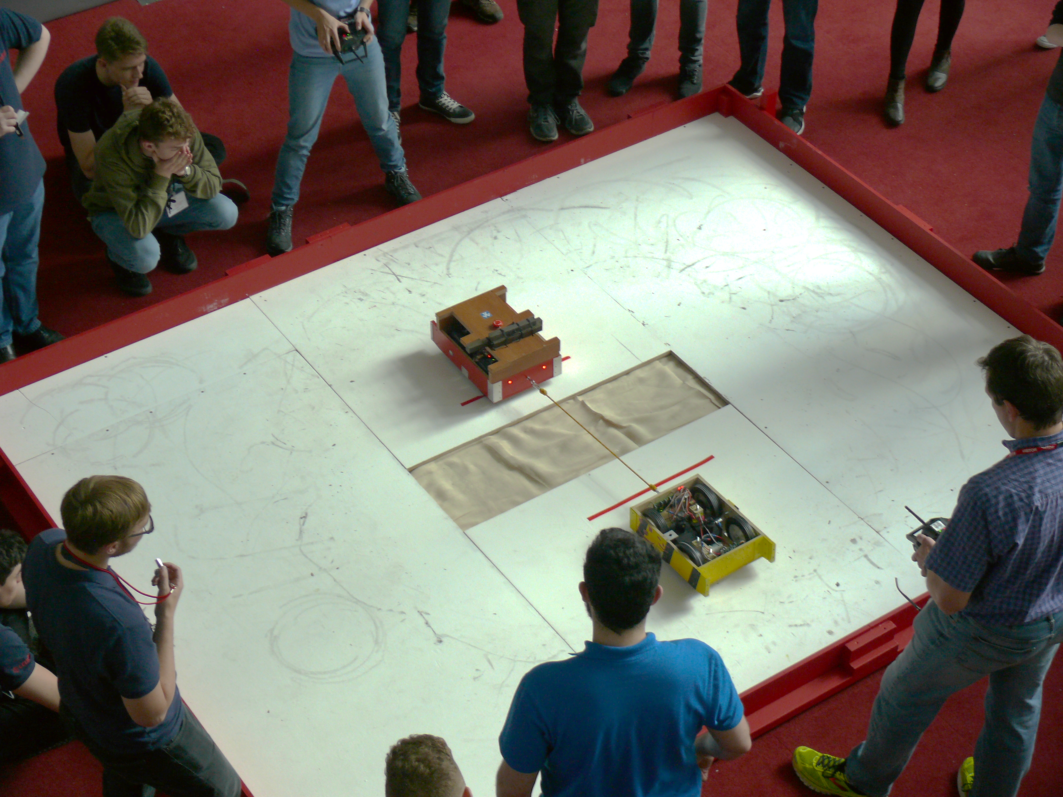
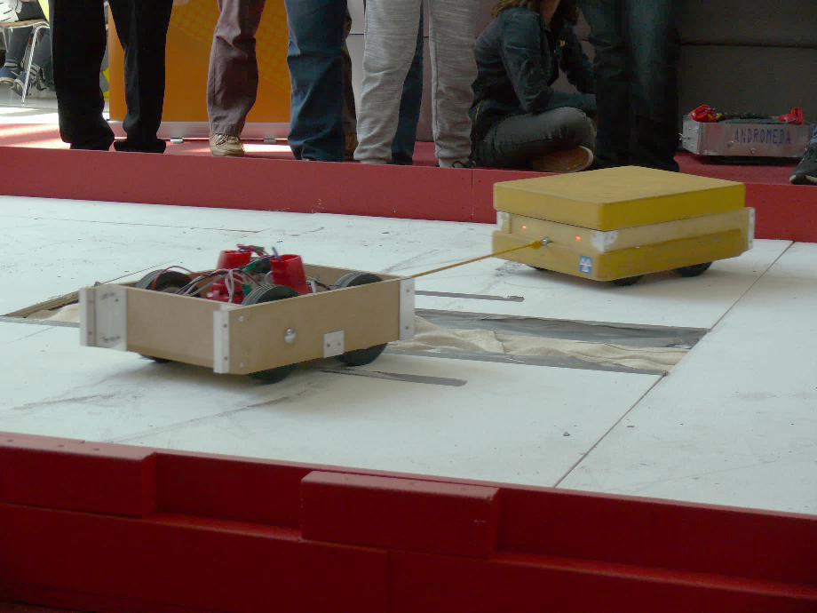
Tug of War
Two chariots compete head to head to try pull the other chariot over the line.
It is the best of three and the winner will go through to the next round.

Slide 11


The Competition
Leonardo 2023 event:
www.youtube.com/watch?v=vHNX1oNy6Zs

Slide 12
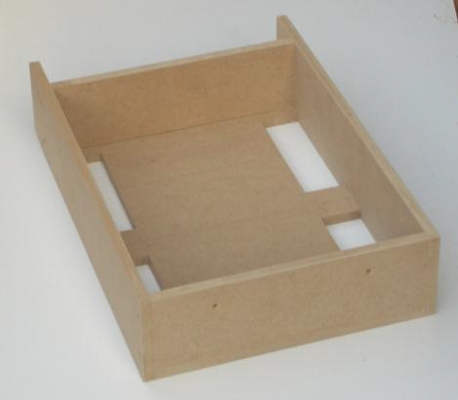
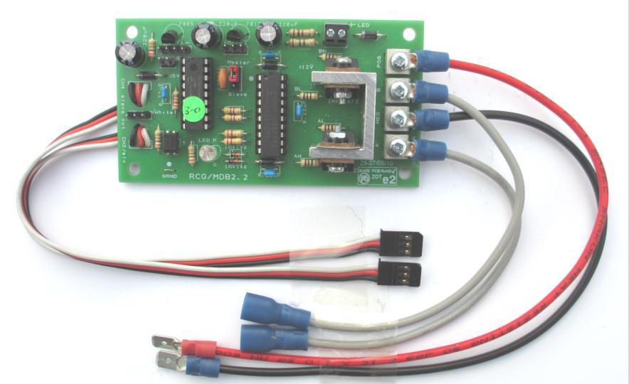
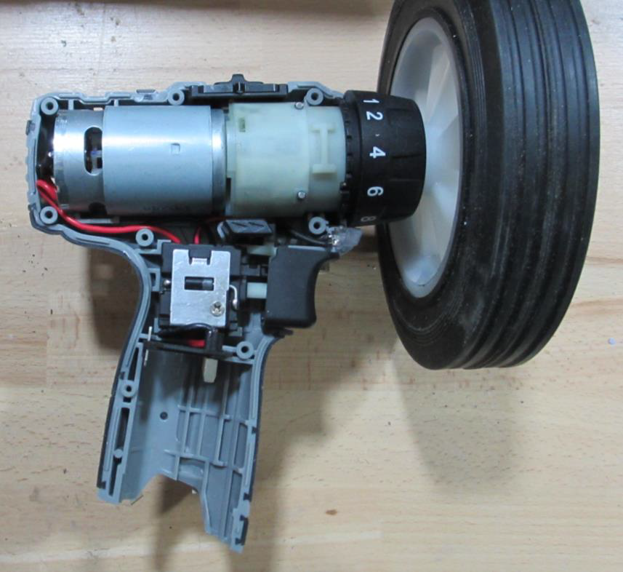
Construction
The Chassis
The Electronics
The Motors

Slide 13
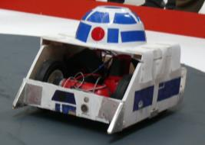
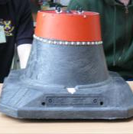
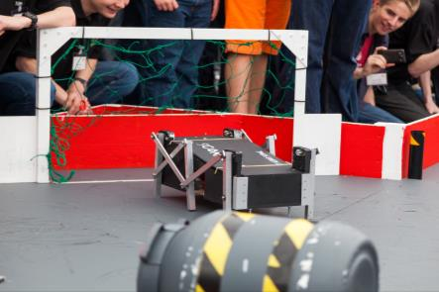
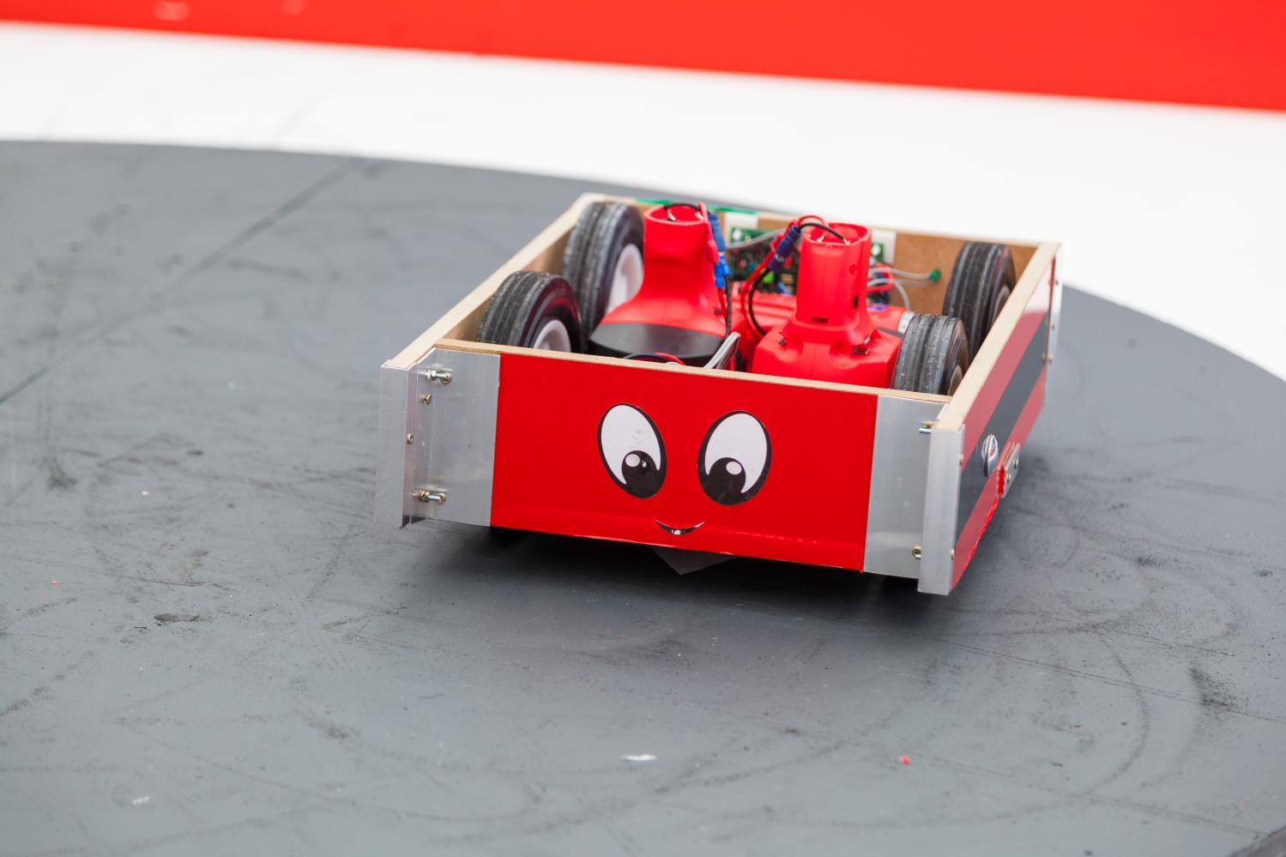
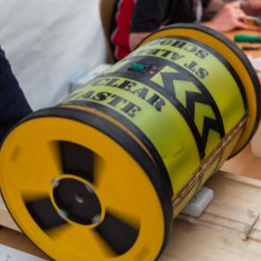
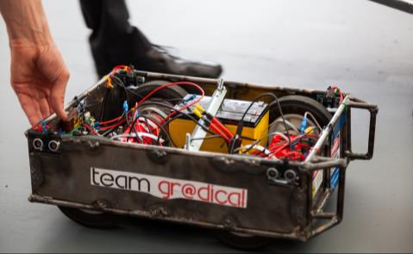
Chassis Design

Slide 14
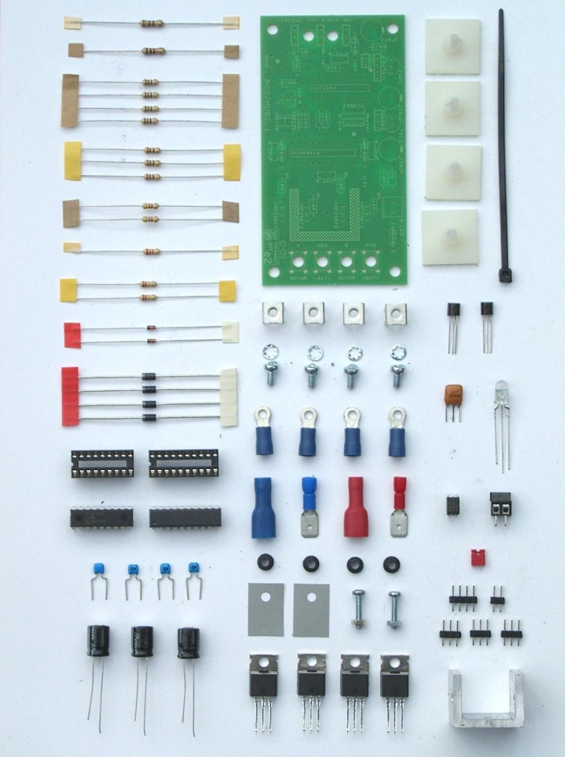
Motor Controller

Slide 15
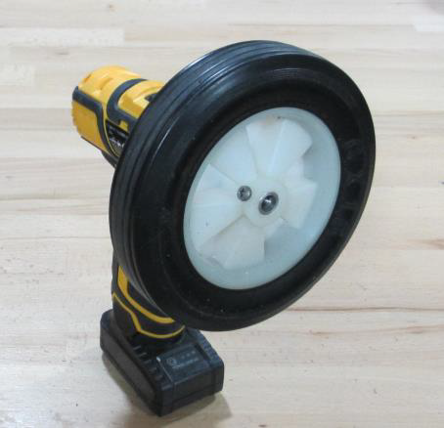
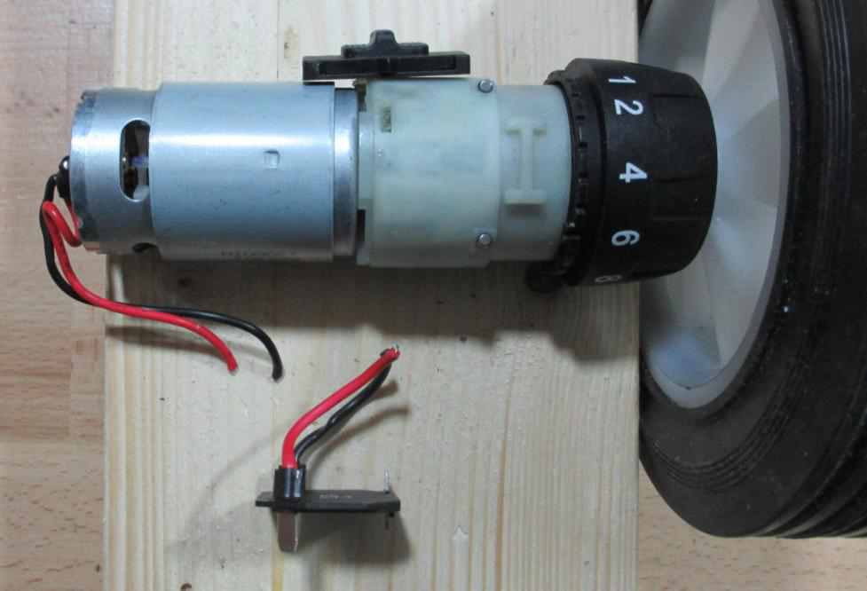
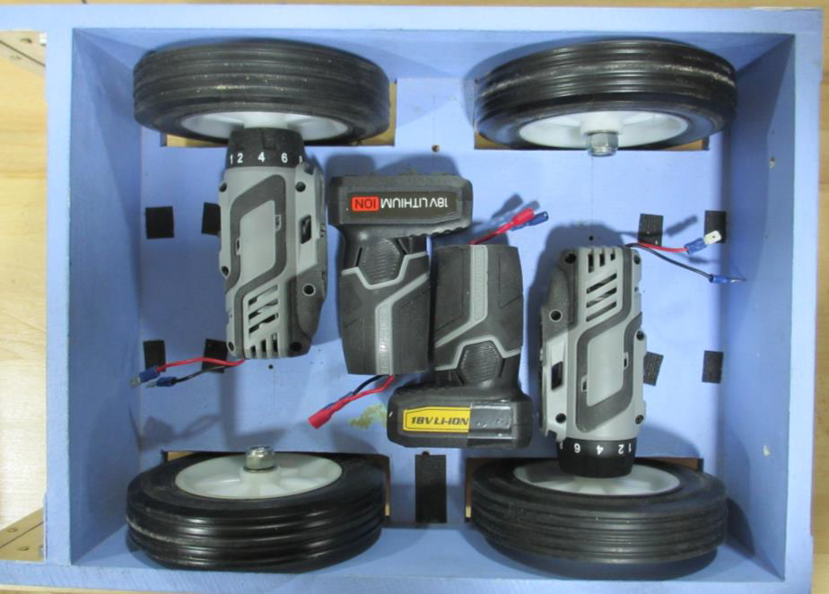

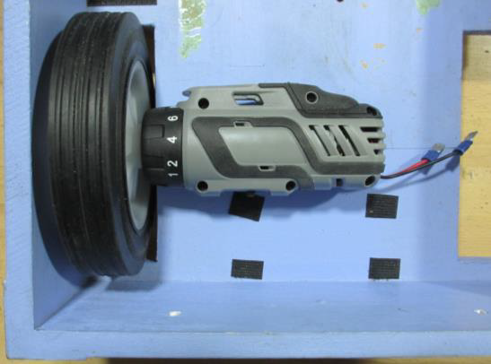
Drill Motors

Slide 16


Getting Started
Open up your kit.
All the parts are provided.
Read the manual very carefully before starting.
Rampaging Chariots website: rampagingchariots.org.uk

Slide 17
Any Questions?
Thank you for listening

